Slide 1
Keys to Survivor Victim Relationship Building
Arizona Crime Victim Rights Law Group
Colleen Hendricks, M.A., M.Ed.
Randall Udelman, Esq.
Dan Levey, M.Ed.

Slide 2
Agenda
Trauma
How Victims May Present
Survivor Victim Concerns
Planning Ahead
Knowing Your Agency
Being Prepared
Set Up for Success
The First Meeting With Victim(s)
Helpful Communication

Slide 3
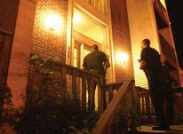
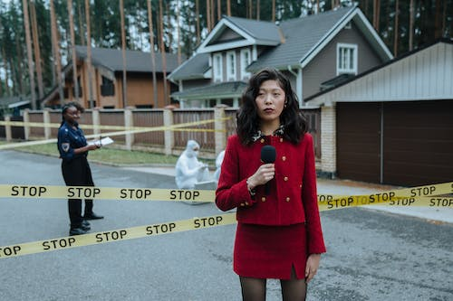
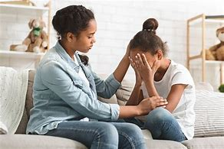
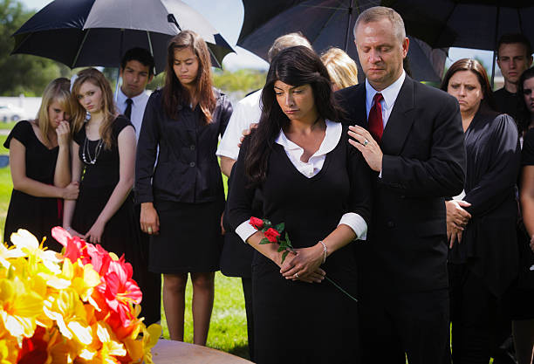
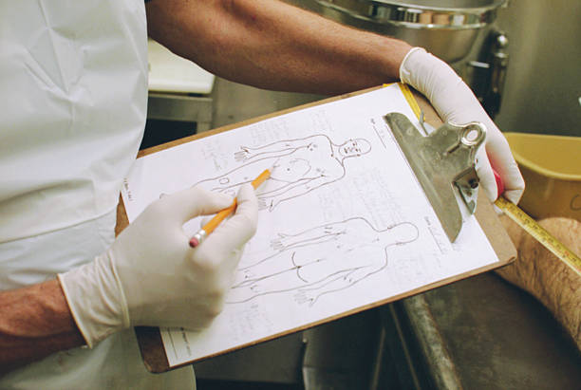
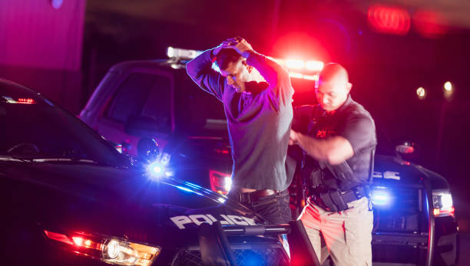
Possible Victim Survivor Trauma Experiences

Slide 4
Grief Process – No Typical “Process”
5 stages of grief: Denial, Anger, Bargaining, Depression, Acceptance
Elizabeth Kubler Ross, On Grief and Grieving
“The stages have evolved since their introduction, and have been very misunderstood over the past three decades. They were not meant to help tuck messy emotions into neat packages. They are responses to loss that many people have, but there is not a typical response to loss, as there is not typical loss. Our grief is as individual as our lives. Not everyone goes through all of them or goes in a prescribed order.”

Slide 5
How Survivor Grief “Feelings” May Present
Helpless and Hopeless
Irritated to Raging
Isolated
Nobody Cares
Guilt Ridden
Blaming and Shaming
Overwhelmed
Confused
Sad or Depressed
Demanding
Medicated
Quiet to Can’t Stop Talking
Fixated
Dismissive
Fearful
Controlling
Frustrated
Inattentive
Uninterested
Clueless
Burdened
Talks About Suicide

Slide 6
Survivor Concerns
Public sympathy for perpetrators of crime.
Disparities in the judicial system.
Leniency of murder sentencing.
The Death Penalty.
Plea bargains.
Sensational and inaccurate media coverage.
Lack of information about the case.
It’s just a job for the prosecutor.
Judge, prosecutor, advocate and defense attorney rotations.
The endless wait.
Return of personal property of the victim.

Slide 7
Victims Didn’t Have a Plan – You Can
Know your agency.
Victim safe areas and how to access.
Do you have on-site assistance for a medical emergency?
Interpretation Services – who requests and when?
Can victims attend hearings virtually?
Is a wheelchair accessible if needed?
Does your Victim Compensation assist with travel expenses of 1st or 2nd degree victims?
Is communication between advocates and victims confidential?
Confirm advocates are versed in discoverable v exculpatory disclosures?

Slide 8
Be Prepared In Advance of Victim Contact
Pre-planned handouts:
Copy of Victim Rights.
Copy of definitions - names of hearings with non-professional descriptions and, if possible, in the victim’s fluent language.
Capital litigation flow chart with realistic timelines will aid both the victim and the prosecutor – great in fluent language.
Have Victim Compensation Applicants available if needed.
Business Cards of prosecutor and advocate.
Request/invite Victim Advocate to participate in meetings.
Know victim’s name and the names and relationships of survivors with whom you will be communicating.
Is interpreter needed? This is critical for accurately relaying and absorbing information. Family members shouldn’t be tasked.
Have water, tissue, writing paper and pencils or pens available.
Practice - pay attention to how your stress effects you and other people, and vice versa.

Slide 9
The Agenda is Critical to Planning
Make a list of topics to be discussed with Victim during initial contact meeting.
Introductions
Charges – Death Penalty
Level of Participation – Victim Rights
Expectations
Boundaries and Availability
Timelines
Opportunity for Questions

Slide 10
Communicating WITH Victims
Respect
Thank the victim for meeting with you.
Ask how they wish to be addressed – that may change over time.
Do use the name of the deceased and acknowledge the loss to the survivor. That’s why you’re all here.
Introduce yourself and your advocate, each saying something about their professional role.
Do tell them you have a list of things to discuss and that you have some handouts for them at the end of the meeting.
Do explain charges and what they mean.

Slide 11
Communicating WITH Victims
Dignity
Discuss participation and Victim Rights.
How much do they want to participate?
Ask about expectations and address realistic expectations. Do address fear and safety issues.
Discuss timelines.
Discuss availability – prosecutor, advocates AND victims.
May suggest survivors make a list of questions for your next meeting.
Provide handouts.

Slide 12
Communicating WITH Victims
Fairness and Honesty
Practice Patience.
Listen and See – to what’s being said and the body and facial messages.
Address communication/behaviors if needed – including your own.
Angry directive comments.
Conflict in words spoken and physical or facial demeanor – happens often when the victim doesn’t understand legal terms, and we may catch ourselves doing it when we don’t understand what the victim is saying. CLARIFY
If you say or do something spontaneously that sounds or feels off the wall or inappropriate, the victim heard or saw it. Better to comment/apologize and correct immediately than ignore. Builds trust!

Slide 13
Communicating WITH Victims
Fairness and Honesty
Discuss boundaries and why they exist – ask about cultural boundaries.
Victim Rights as they relate to victim participation.
Capital Punishment and who makes the decisions.
What case information can be shared.
What information personal/professional is confidential.
What interaction boundaries exist.
Commit to honesty, even if information is uncomfortable.
Painful disclosures are less so by using tact and empathy.
Welcome questions and answer them.

Slide 14
Communicating WITH Victims
Fairness and Honesty
Don’t assume the victim’s response to anything.
When possible, explain the situation and know that during stressful times, same questions may be asked repetitively.
It’s okay to say you don’t have the answer and you or the advocate will get back to them with the answer.
Remember to tell them to jot down questions for the next meeting or call the advocate if it’s a question that can’t wait.
Provide available options for scheduling, contact, virtual or in-person, advocate attends for them with follow-up call, only notification, etc.
Include the advocate - demonstrate that you and the advocate are a team.

Slide 15
Final Thoughts
Whether you build trust and rapport, share canned statements, ignore and demonstrate indifference, or are overtly/covertly invalidating with the survivor victim of homicide – they will never forget!
May that memory be a positive force in every survivor’s trauma and grief healing because of YOUR professionalism and the respect, dignity, fairness and honesty you demonstrated to them.
Questions?

Slide 16
Thank You for Participating
Arizona Crime Victim Rights Law Group
480-946-0832
Randall Udelman
rudelman@azvictimrights.org
Colleen Hendricks
chendricks@azvictimrights.org
Dan Levey
dlevey@azvictimrights.org

